Slide 1


Charged-particle nuclear modification factor in PbPb collisions using the ANGANTYR model
Robert Pierrard
Vanderbilt University Heavy Ion Group
Georgia Institute of Technology

Slide 2


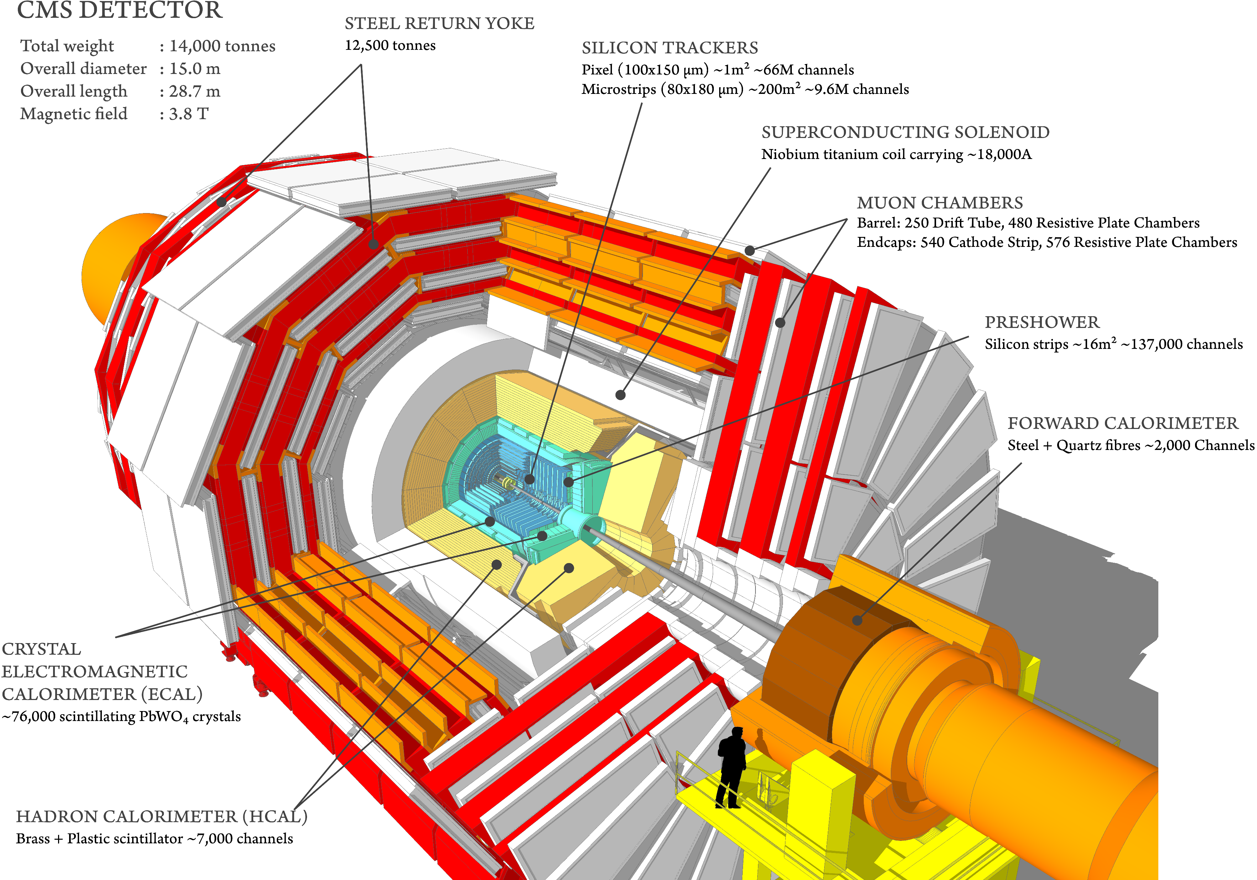
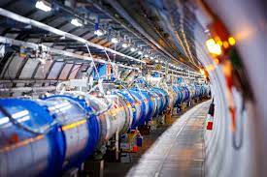
Group Context
Robert
Vanderbilt’s Heavy Ion Group
CMS Collaboration
CERN

Slide 3
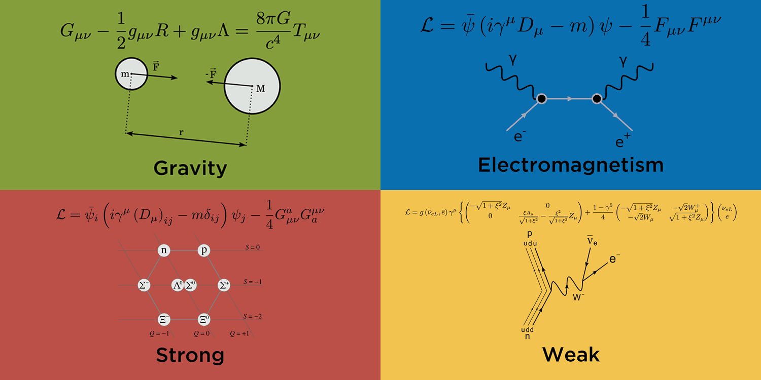
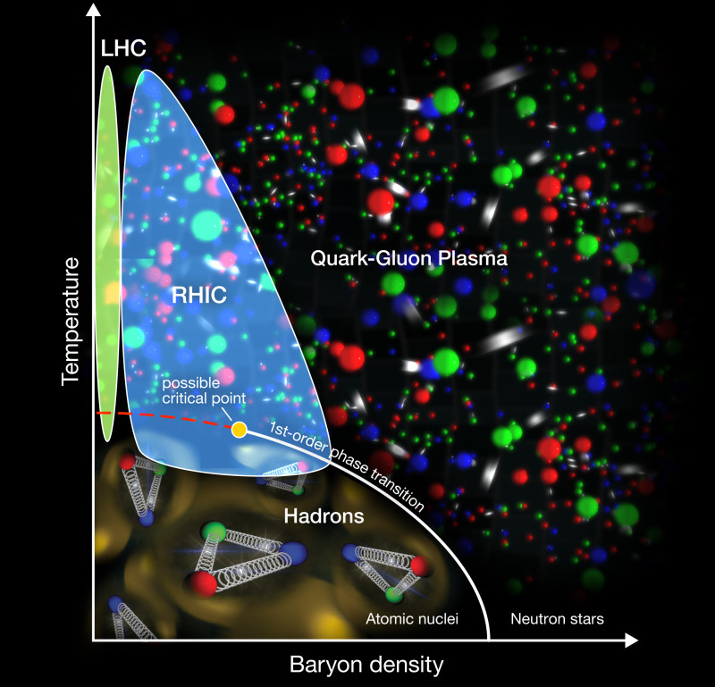
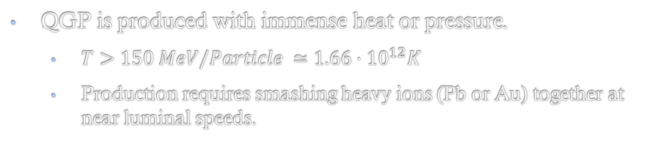
An exotic state of matter
Quark-gluon plasma (QGP) is a state of matter where particles (quarks and gluons) are freed from the strong interaction.
https://briankoberlein.com/blog/four-horsemen/
QGP is produced with immense heat or pressure.
$T>150 MeV/Particle$ $≃1.66⋅{10}^{12}K$
Production requires smashing heavy ions (Pb or Au) together at near luminal speeds.
Alternatively, we can simulate these collisions with various simulation programs.
I am using Pythia8 and more specifically the ANGANTYR model within it.
http://sites.coloradocollege.edu/pc357ml/2014/04/10/the-quark-gluon-plasma/

Slide 4
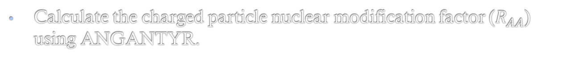
Goals
Methods
“Help uncover the universe and how it works.”
The strong nuclear force.
Use ANGANTYR model to simulate pp and PbPb collisions
Test a newly established model known as ANGANTYR.
Extract relevant parameters from raw collision data
Calculate the charged particle nuclear modification factor ($R_{AA}$) using ANGANTYR.
Use ROOT to process data and produce figures
(Personally) - Develop an understanding of a computationally intensive research experience.
Compare data and figures from simulations with real CMS data.

Slide 5
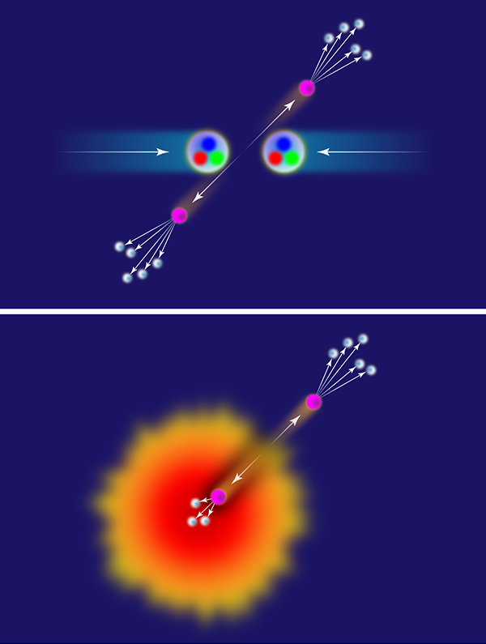
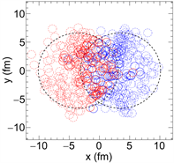
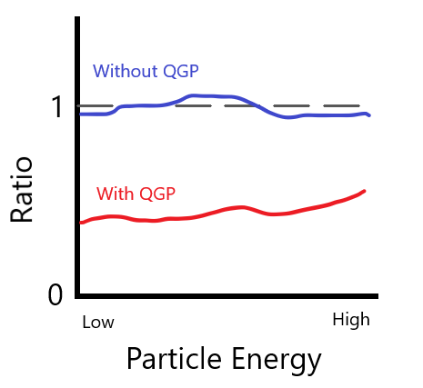
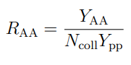

Some relevant parameters
Nuclear Modification Factor ($R_{AA}$)
Jet Quenching
Number of Collisions

Slide 6
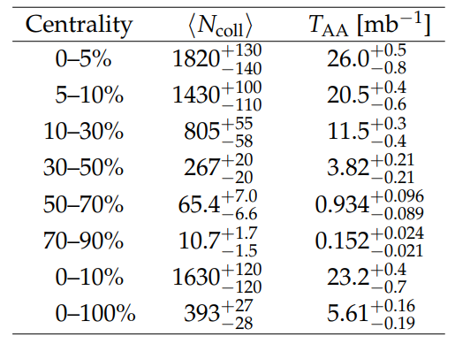
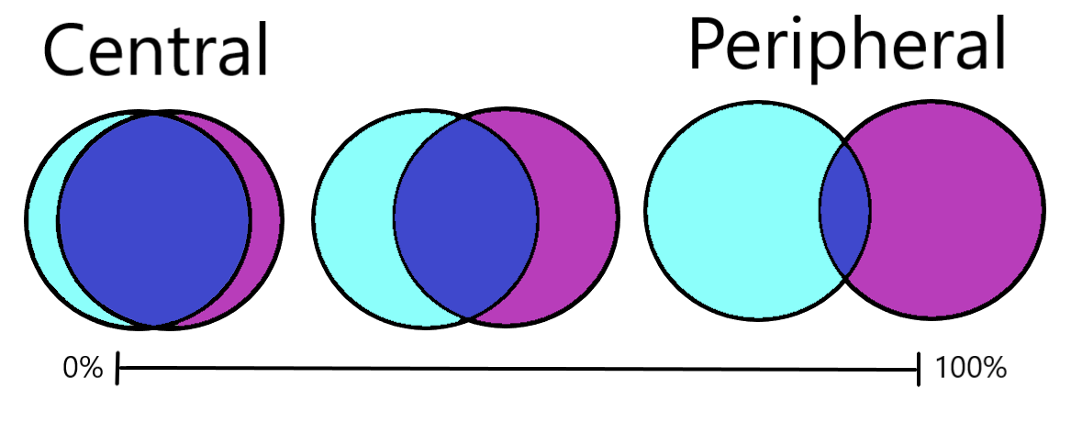
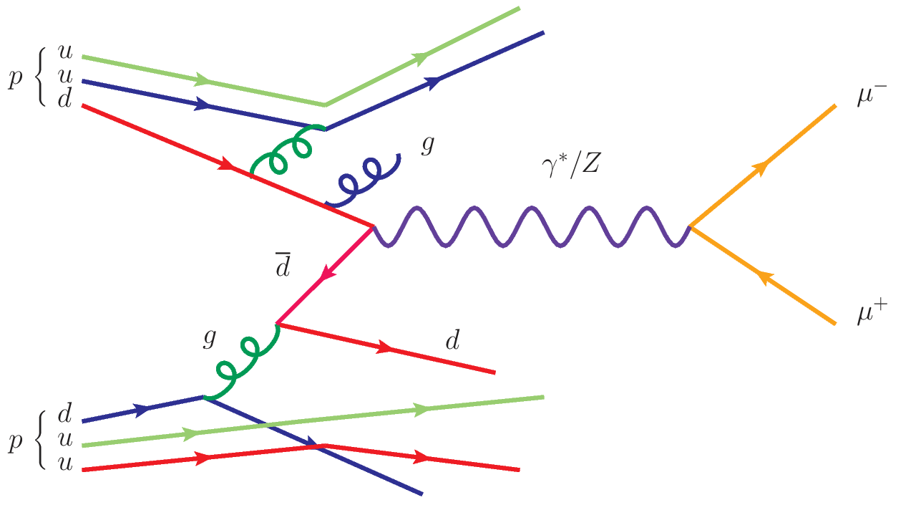
Challenges Faced
Discovered “number of collisions” in the ANGANTYR model is incorrect
Used CMS data as a replacement.
Processing extremely large datasets.
Provide some info on processing times and data size.
Knowledge gap, curiosity regarding underlying physics.
Centrality

Slide 7
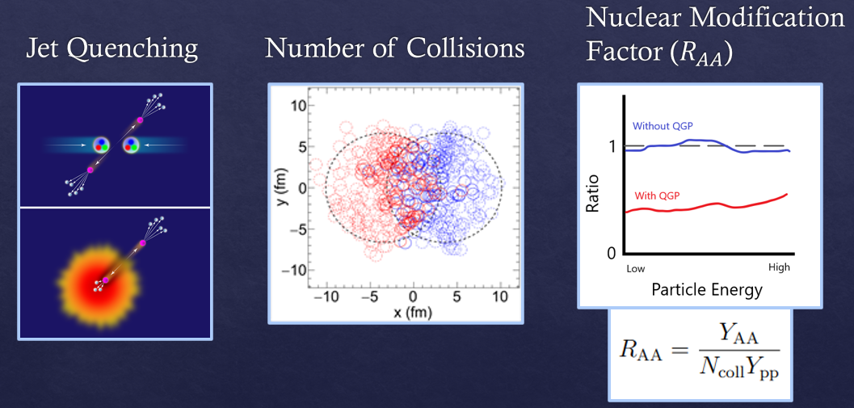
Challenges Faced
Discovered “number of collisions” in the ANGANTYR model is incorrect
Used CMS data as a replacement.
Processing extremely large datasets.
Provide some info on processing times and data size.
Knowledge gap, curiosity regarding underlying physics.
Centrality

Slide 8

Computational Requirements
Event Generation:
Raw data generated: 850 GB
Total processing time: ~8,000 hours
Number of jobs submitted: 700
+ more computation for data analysis.

Slide 9
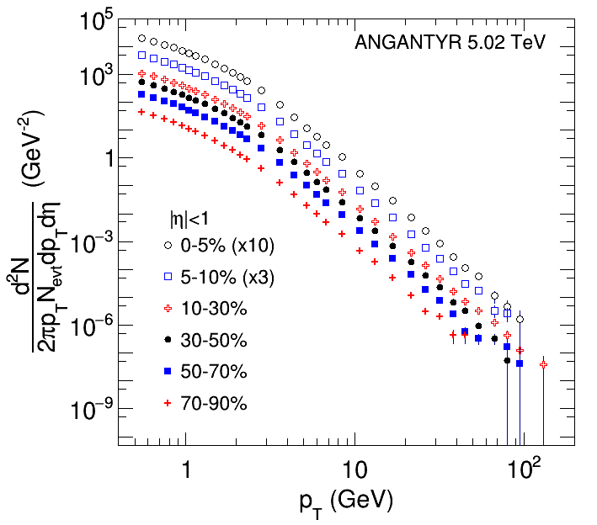
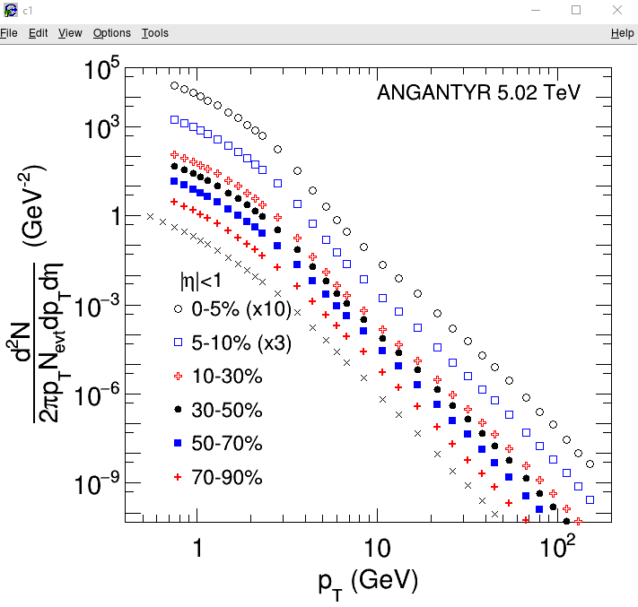
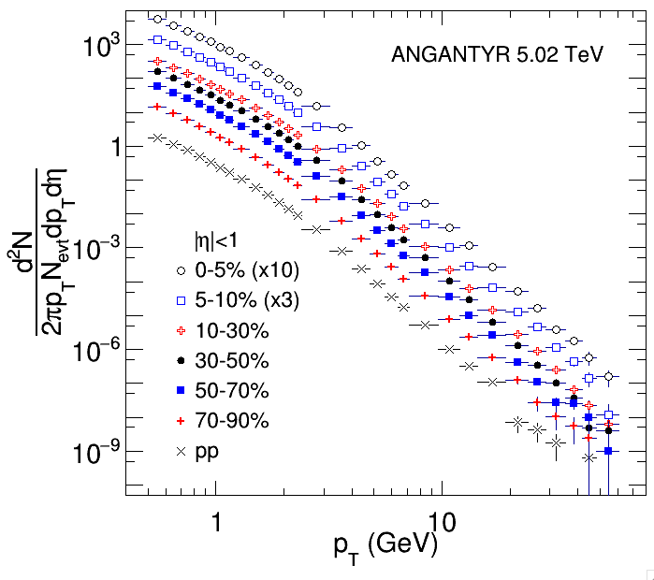

$p_{T}$ Spectra Figures
Large Batch ANGANTYR
CMS Data
Small batch ANGANTYR
3.6 million events.
Much fewer events.

Slide 10
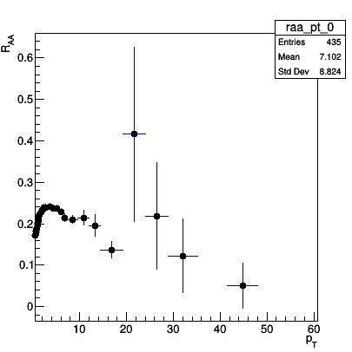
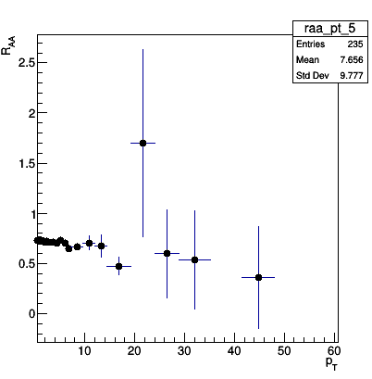
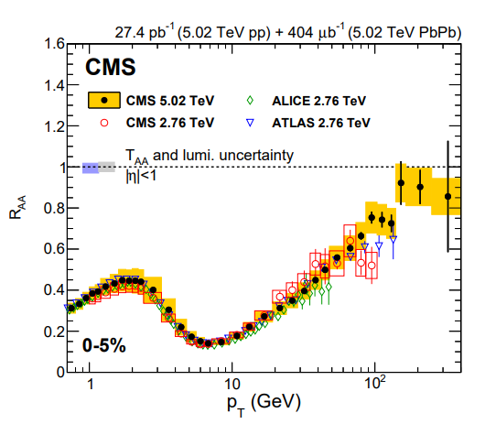
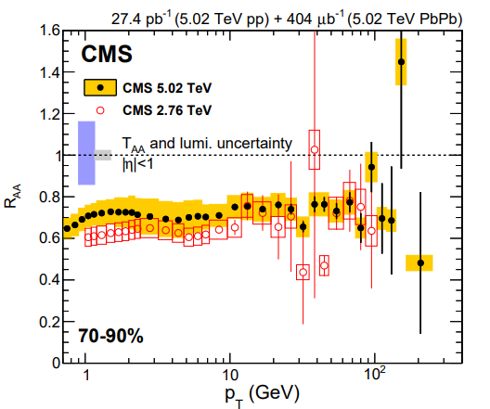

$$R_{AA} Figures$$
Small Batch ANGANTYR
CMS Data

Slide 11
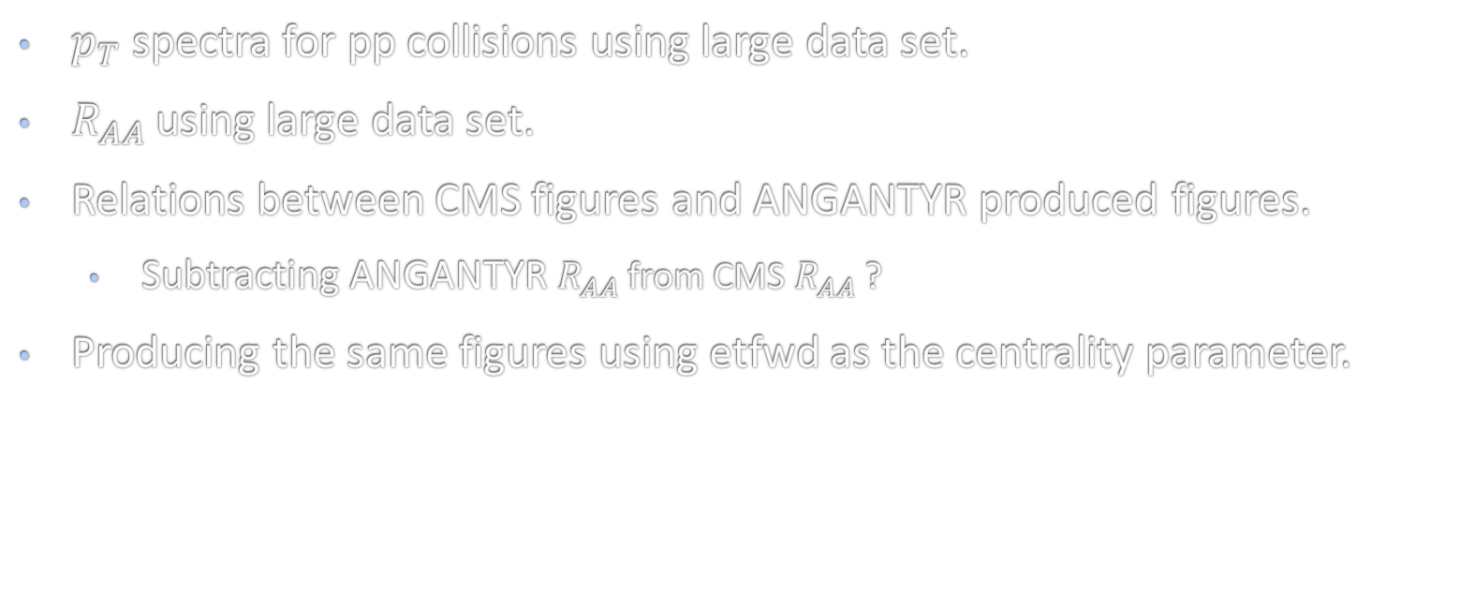
Additional Figures
$p_{T}$ spectra for pp collisions using large data set.
$R_{AA}$ using large data set.
Relations between CMS figures and ANGANTYR produced figures.
Subtracting ANGANTYR $R_{AA}$ from CMS $R_{AA}$ ?
Producing the same figures using etfwd as the centrality parameter.

Slide 12
Moving Forward

Slide 13
Summary/Context

Slide 14
Supplemental Slides

Slide 15
What is ANGANTYR?
Monte-Carlo Glauber Model
Direct extrapolation of high energy pp collisions.
Collective effects are not simulated.

